Slide 1
Chapter 04
Knowledge Capture and Codification

Slide 2
Objectives
Knowledge Capture
  For tacit knowledge
  For explicit knowledge
Knowledge Codification
  Organizing knowledge in a knowledge taxonomy

Slide 3
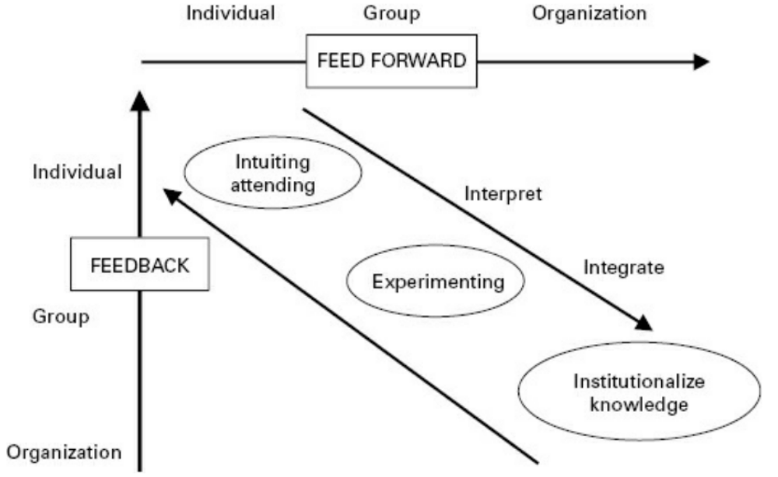
Learning
Learning at individual level is social process
Individuals learn from
group <==> group learns from individual
Knowledge Acquisition must be embedded into corporate memory to be valuable

Slide 4
Approaches to Knowledge Capture and Codification
How to describe and represent knowledge
  Depending on the type of knowledge
  E.g. explicit knowledge is already well described but may need to abstract/summarize it
  Tacit knowledge on the other hand may require significant analysis and organization before it can be suitably described and represented
Tools range from linguistic descriptions and categories to mathematical formulations and graphical representations

Slide 5
Tacit Knowledge Capture
More time-consuming than explicit knowledge capture
Requires more up-front analysis and organization
Tacit Knowledge Capture
  Ad Hoc Sessions, Roadmap, Learning History, Storytelling, Interviews, Action Learning, Learn from Others, Guest Speakers, Relationship Building, Systems Thinking

Slide 6
Tacit Knowledge Capture Techniques
Interviewing experts, stakeholders, others
  Open and closed questions
Capturing Stories
  All communities/organizations have stories
  Story telling builds social capital and networks
  Social capital - informal norm that promotes cooperation between two or more individuals

Slide 7
Tacit Knowledge Capture Techniques
Learning by being told
  Similar to interviewing
Learning by observation
  Expertise – demonstration of application of knowledge
    Can’t observe knowledge but can observe application of knowledge
  Skill based expertise
    Operating machinery
  Cognitive expertise
    Making a medical diagnosis

Slide 8
Knowledge Codification
Convert knowledge to tangible, explicit form
  Can be communicated widely and with less cost
Methods
  Proficiency Levels and Knowledge Profiles
  Abstract Concept Representation (mental model)
  Concept hierarchies
    Associative: Decision Tree
    Semantic network: Knowledge Taxonomy
  Systematic review of successes and failures

Slide 9
Cognitive Maps
Cognitive Map is representation of person’s mental model
Mental model is representation of something in the real world
  How humans process and make sense of environment
Cognitive mapping is based on concept maps
A concept map includes two parts - concepts and the relationships among the concepts.
  Concepts are usually enclosed in nodes.
  The relationships are usually indicated by a line, or a link, that connect two concepts.

Slide 10
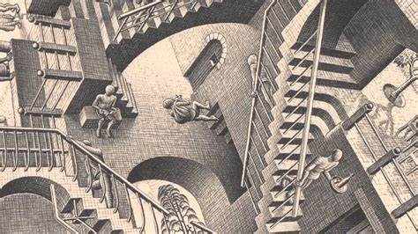
Cognitive Maps

Slide 11
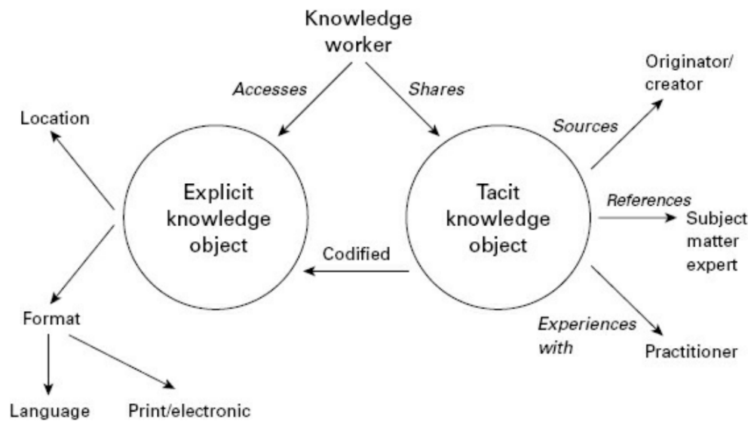
Examples of Concept Map
in Text – major differences between tacit and explicit knowledge

Slide 12
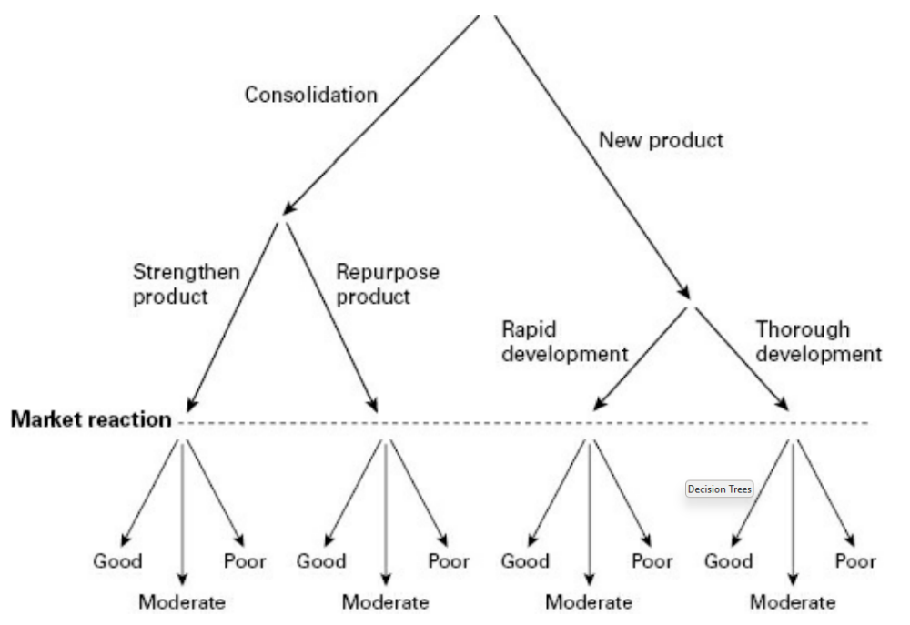

Decision Trees
Decision trees represented in form of flow chart
  Alternate paths indicate the impact of different rules at different points
  Do not have to look at all rules, can bypass those that are irrelevant, find shortest path

Slide 13
Knowledge taxonomies
Concepts are the building blocks of knowledge and expertise.
  Once key concepts have been identified and captured, they can be arranged in a hierarchy – a knowledge taxonomy
  Graphically represent knowledge in a way that reflects the logical organization of concepts within a particular field of expertise or for the organization at large

Slide 14
Knowledge taxonomies (con’t)
A taxonomy is a classification scheme that
  Groups related items together
  Names the types of relationships concepts have to one another
  Is developed through a consensus of key stakeholders?
  Is often multifaceted to represent the complexity of organizational knowledge?

Slide 15
Best Practice Capture
Best practices and lessons learned can be said to be two different sides of the same coin
Best Practices look at successes
Lessons Learned look at failures

Slide 16
Summary
Tacit Knowledge Capture Techniques
  Ad Hoc Sessions, Roadmap, Learning History
  Storytelling, Interviews, Action Learning,
  Learn from Others, Guest Speakers,
  Best Practice capture

Slide 17
Summary
Tacit Knowledge Codification Techniques
  Mental models
  Concept hierarchies, semantic networks
  Best practices, lessons learned

Slide 18

Tacit Knowledge Capture Activity
Form pairs
Take on role of knowledge journalist or subject matter expert and then switch
Topic suggestion: How did you decide on what to do for your undergraduate degree? Whose advice did you seek? How would you advise someone to make this decision?
Try to identify at least one best practice or lessons learned
Homework - Develop a decision tree for deciding on UG degree

